Slide 1

No SQL Database
Dept of CSE

Slide 2
Course Objectives
CLO 1. Recognize and Describe the four types of NoSQL Databases, the Document-oriented, Key-Value pairs
CLO 2. Column-oriented and Graph databases useful for diverse applications.
CLO 3. Apply performance tuning on Column-oriented NoSQL databases and Document-oriented NoSQL Databases.
CLO 4. Differentiate the detailed architecture of column oriented NoSQL database, Document database and Graph Database and relate usage of processor, memory, storage and file system commands.
CLO 5. Evaluate several applications for location based service and recommendation services. Devise an application using the components of NoSQL
Dept of CSE
Course Outcomes
CO1. Demonstrate an understanding of the detailed architecture of Column Oriented NoSQL databases, Document databases, Graph databases.
CO2. Use the concepts pertaining to all the types of databases.
CO3. Analyze the structural Models of NoSQL.
CO4. Develop various applications using NoSQL databases.

Slide 3
Assessment Details (both CIE and SEE)
Continuous Internal Evaluation:
Three Unit Tests each of 20 Marks (duration 01 hour) 60M
Two assignments each of 10 Marks 20M
Group discussion/Seminar/quiz any one of three suitably planned 20M
CIE 100 M --> 50 M
SEE 100M ---> 50M
Dept of CSE

Slide 4
Textbooks
1. Sadalage, P. & Fowler, NoSQL Distilled: A Brief Guide to the Emerging World of Polyglot Persistence, Pearson Addision Wesley, 2012
Reference Books
Dan Sullivan, "NoSQL For Mere Mortals", 1st Edition, Pearson Education India, 2015. (ISBN- 13: 978-9332557338)
2. Dan McCreary and Ann Kelly, "Making Sense of NoSQL: A guide for Managers and the Rest of us", 1st Edition, Manning Publication/Dreamtech Press, 2013. (ISBN-13: 978-9351192022)
3. Kristina Chodorow, "Mongodb: The Definitive Guide- Powerful and Scalable Data Storage", 2nd Edition, O'Reilly Publications, 2013. (ISBN-13: 978-9351102694)
Dept of CSE

Slide 5
Weblinks and Video Lectures (e-Resources):
1. https://www.geeksforgeeks.org/introduction-to-nosql/ ( and related links in the page)
2. https://www.youtube.com/watch?v=0buKQHokLK8 (How do NoSQL databases work? Simply
explained)
3. https://www.techtarget.com/searchdatamanagement/definition/NoSQL-Not-Only-SQL (What is
NoSQL and How do NoSQL databases work)
4. https://www.mongodb.com/nosql-explained (What is NoSQL)
5. https://onlinecourses.nptel.ac.in/noc20-cs92/preview (preview of Bigdata course contains
NoSQL)
Dept of CSE

Slide 6
Module - 4
Document Databases, What Is a Document Database?, Features, Consistency, Transactions, Availability, Query Features, Scaling, Suitable Use Cases, Event Logging, Content Management Systems, Blogging Platforms, Web Analytics or Real-Time Analytics, E- Commerce Applications, When Not to Use, Complex Transactions Spanning Different Operations, Queries against Varying Aggregate Structure.
Dept of CSE

Slide 7
Document Databases
Basically we have different types of databases Relational, Object Oriented, Normal,
Key Value, document, Columnar and Graph databases.
Document Database
A Database in one which have document as a database.
Document databases are considered to be non-relational (or NoSQL) databases. Instead of storing data in a fixed rows and columns, document databases use flexible documents. Document databases are the most popular alternative to tabular, relational databases.
Example : RDBMS
Dept of CSE

Slide 8
Document Databases
RDBMS: Database is structured database. Data is stored in the form of tables containing rows and columns. Each table defines its own structures. We can also have multiple tables leads to database.
Ex: Student table, Faculty Table, Course Table and etc…
Where as in Document databases, all these data is organized in a document form. All the tables are stored in a document also. Because it is flexible in nature.
What are documents?
A document is a record in a document database. A document typically stores information about one object and any of its related metadata.
Documents store data in a fixed value pairs. The values can be variety of types and structures, including strings, numbers, dates, arrays or objects.
Documents can be stored in formats like JSON, BSON and XML.
Below JSON document that stores information about a user name Tom.
{“_id”:1,”First_name”: ”Tom”, ”email”: “tom@example.com”, “cell”: “765-55-5555”, “likes”: [“fashion”, “spas”, “shopping” ], “business”: [{ “name”: “entertainment 1080”, “partner”: “Jean”, “status”: “Bankrupt”, “date_founded”: {“$date”: “2012-05-19T04:00:00Z”} }, { “name”: “Swag for Tweens”, “date_founded”: { “$date”: “2012-11-01T04:00:00z”}} ] }
Dept of CSE

Slide 9
Document Databases
Properties
Documents are the main concept in document databases.
The database stores and retrieves documents, which can be XML, JSON, BSON, and so on.
These documents are self-describing, hierarchical tree data structures which can consist of maps, collections, and scalar values.
The documents stored are similar to each other but do not have to be exactly the same.
Document databases store documents in the value part of the key-value store; think about document databases as key-value stores where the value is examinable.
Dept of CSE

Slide 10
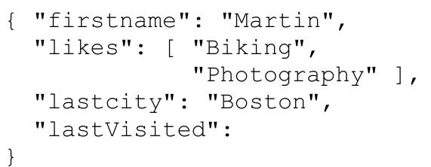
Document Databases
Properties
This document can be considered a row in a traditional RDBMS. Let’s look at another document:
{
"firstname": "Pramod",
"citiesvisited": [ "Chicago", "London", "Pune", "Bangalore" ],
"addresses": [
{ "state": "AK",
"city": "DILLINGHAM",
"type": "R"
},
{ "state": "MH",
"city": "PUNE",
"type": "R" }
],
}
"lastcity": "Chicago"
}
Dept of CSE
we can see here like similar, but have differences in attribute names. This is allowed in document databases. The schema of the data can differ across documents, but these documents can still belong to the same collection—unlike an RDBMS where every row in a table has to follow the same schema. We represent a list of citiesvisited as an array, or a list of addresses as list of documents embedded inside the main document. Embedding child documents as sub-objects inside documents provides for easy access and better performance.

Slide 11
Document Databases
Some of the popular document databases we have seen are
MongoDB,
CouchDB,
Terrastore,
OrientDB,
RavenDB,
Lotus Notes
Dept of CSE

Slide 12
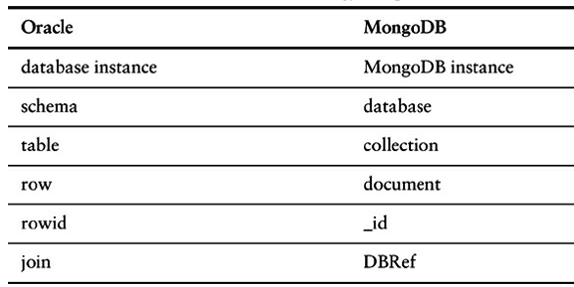
Document Databases
Document Databases compares in Oracle and MongoDB.
Dept of CSE
The _id is a special field that is found on all documents in Mongo, just like ROWID in Oracle. In MongoDB, _id can be assigned by the user, as long as it is unique.

Slide 13
Document Databases
Collections
A collection is a group of documents. Collections typically store documents that have similar contents.
Not all documents in a collection are required to have the same fields, because document databases have a flexible schema. Note that some document databases provide schema validation, so the schema can optionally be locked down when needed.
Continuing with the example above, the document with information about Tom could be stored in a collection in order to store information about users. For example, the document below that stores information about Donna could be added to the users collection.
{“_id”:2,”First_name”: ”Donna”, ”email”: “donna@example.com”, “Spouse”: “Joe”, “likes”: [“spas”, “shopping”, “live tweeting” ], “business”: [{ “name”: “Castle Reality”, “status”: “Thriving”, “date_founded”: {“$date”: “2013-11-21T04:00:00Z”} } ] }.
Note that the document for Donna does not contain the same fields as the document for Tom. The users collection is leveraging a flexible schema to store the information that exists for each user.
Dept of CSE

Slide 14
Document Databases
Features of Document Based database
This is a data model which works as a semi-structured data model in which the records and data associated with them are stored in a single document which means this data model is not completely unstructured. The main thing is that data here is stored in a document
Document Type Model: As we all know data is stored in documents rather than tables or graphs, so it becomes easy to map things in many programming languages.
Flexible Schema: Overall schema is very much flexible to support this statement one must know that not all documents in a collection need to have the same fields.
Distributed and Resilient: Document data models are very much dispersed which is the reason behind horizontal scaling and distribution of data.
Manageable Query Language: These data models are the ones in which query language allows the developers to perform CRUD (Create Read Update Destroy) operations on the data model.
Dept of CSE

Slide 15
Document Databases
Manageable Query Language
The SQL for this would be:
SELECT * FROM order
The equivalent query in Mongo shell would be:
db.order.find()
Selecting the orders for a single customerId of 883c2c5b4e5b would be:
SELECT * FROM order WHERE customerId = "883c2c5b4e5b“
The equivalent query in Mongo to get all orders for a single customerId of 883c2c5b4e5b:
db.order.find({"customerId":"883c2c5b4e5b"})
Selecting orderId and orderDate for one customer in SQL would be:
SELECT orderId,orderDate FROM order WHERE customerId = "883c2c5b4e5b“
and the equivalent in Mongo would be:
db.order.find({customerId:"883c2c5b4e5b"},{orderId:1,orderDate:1})
Dept of CSE

Slide 16
Document Databases
Advantages:
Schema-less: These are very good in retaining existing data at massive volumes because there are absolutely no restrictions in the format and the structure of data storage.
Faster creation of document and maintenance: It is very simple to create a document and apart from this maintenance requires is almost nothing.
Open formats: It has a very simple build process that uses XML, JSON, and its other forms.
Built-in versioning: It has built-in versioning which means as the documents grow in size there might be a chance they can grow in complexity. Versioning decreases conflicts.
Disadvantages:
Weak Atomicity: It lacks in supporting multi-document ACID transactions. A change in the document data model involving two collections will require us to run two separate queries i.e. one for each collection. This is where it breaks atomicity requirements.
Consistency Check Limitations: One can search the collections and documents that are not connected to an author collection but doing this might create a problem in the performance of database performance.
Security: Nowadays many web applications lack security which in turn results in the leakage of sensitive data. So it becomes a point of concern, one must pay attention to web app vulnerabilities.
Dept of CSE

Slide 17
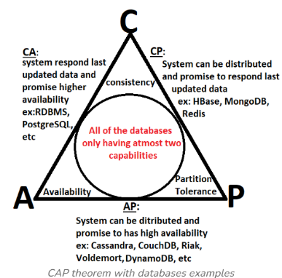
Document Databases
CAP Theorem
Dept of CSE

Slide 18
Document Databases
Applications of Document Data Model :
Content Management: These data models are very much used in creating various video streaming platforms, blogs, and similar services Because each is stored as a single document and the database here is much easier to maintain as the service evolves over time.
Book Database: These are very much useful in making book databases because as we know this data model lets us nest.
Catalog: When it comes to storing and reading catalog files these data models are very much used because it has a fast reading ability.
Analytics Platform: These data models are very much used in the Analytics Platform.
Dept of CSE

